Slide 1
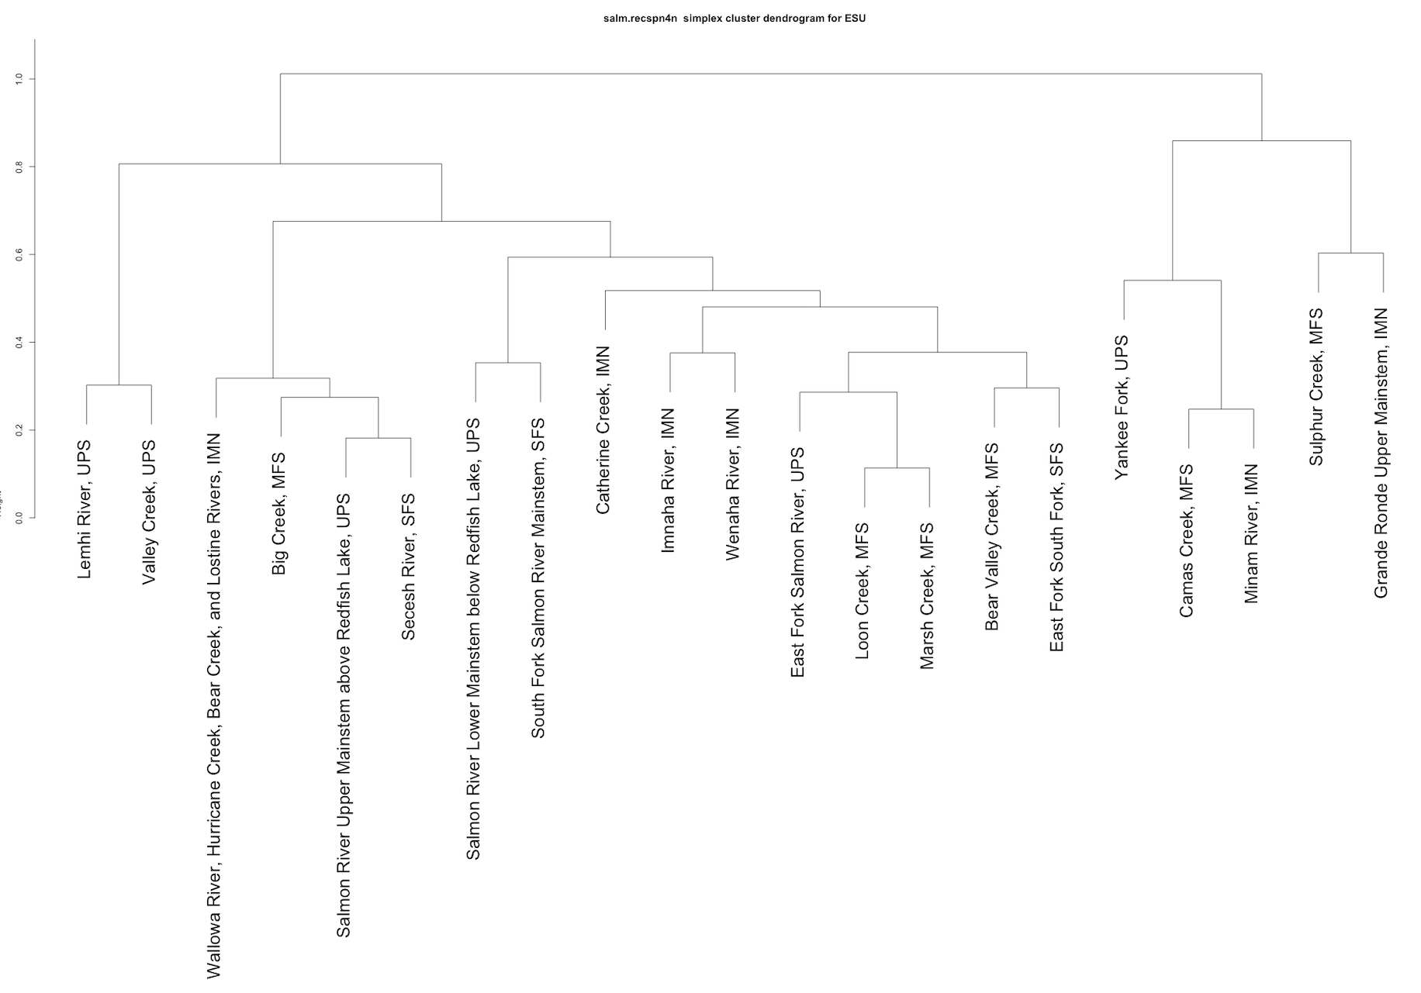
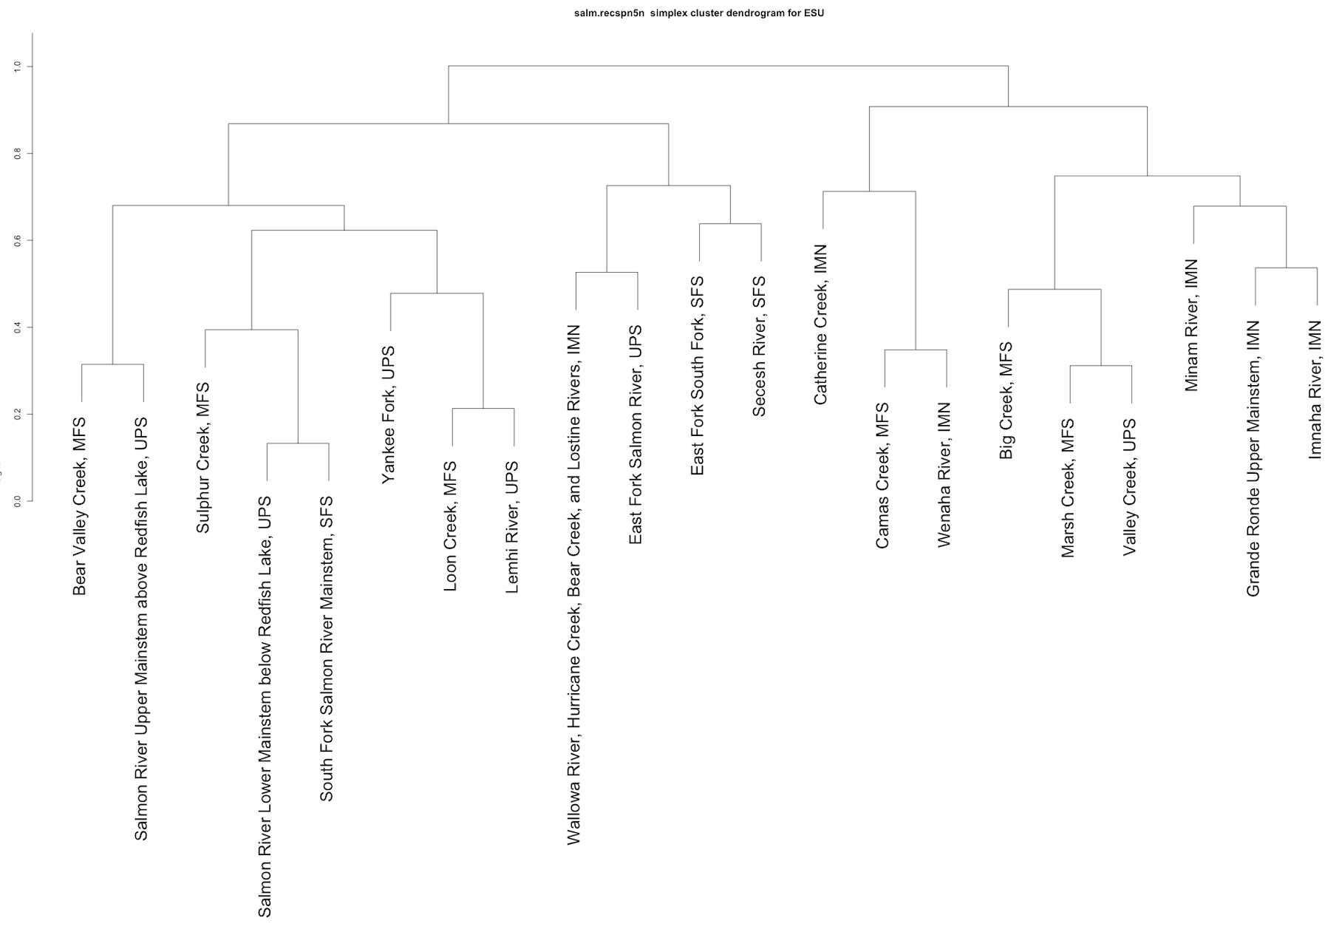
4-year old recruits per spawner
ESU
5-year old recruits per spawner
D_1
D_1
0000
D_2
D_3
D_2
D_3
D_4
D_4
D_5
D_5

Slide 2
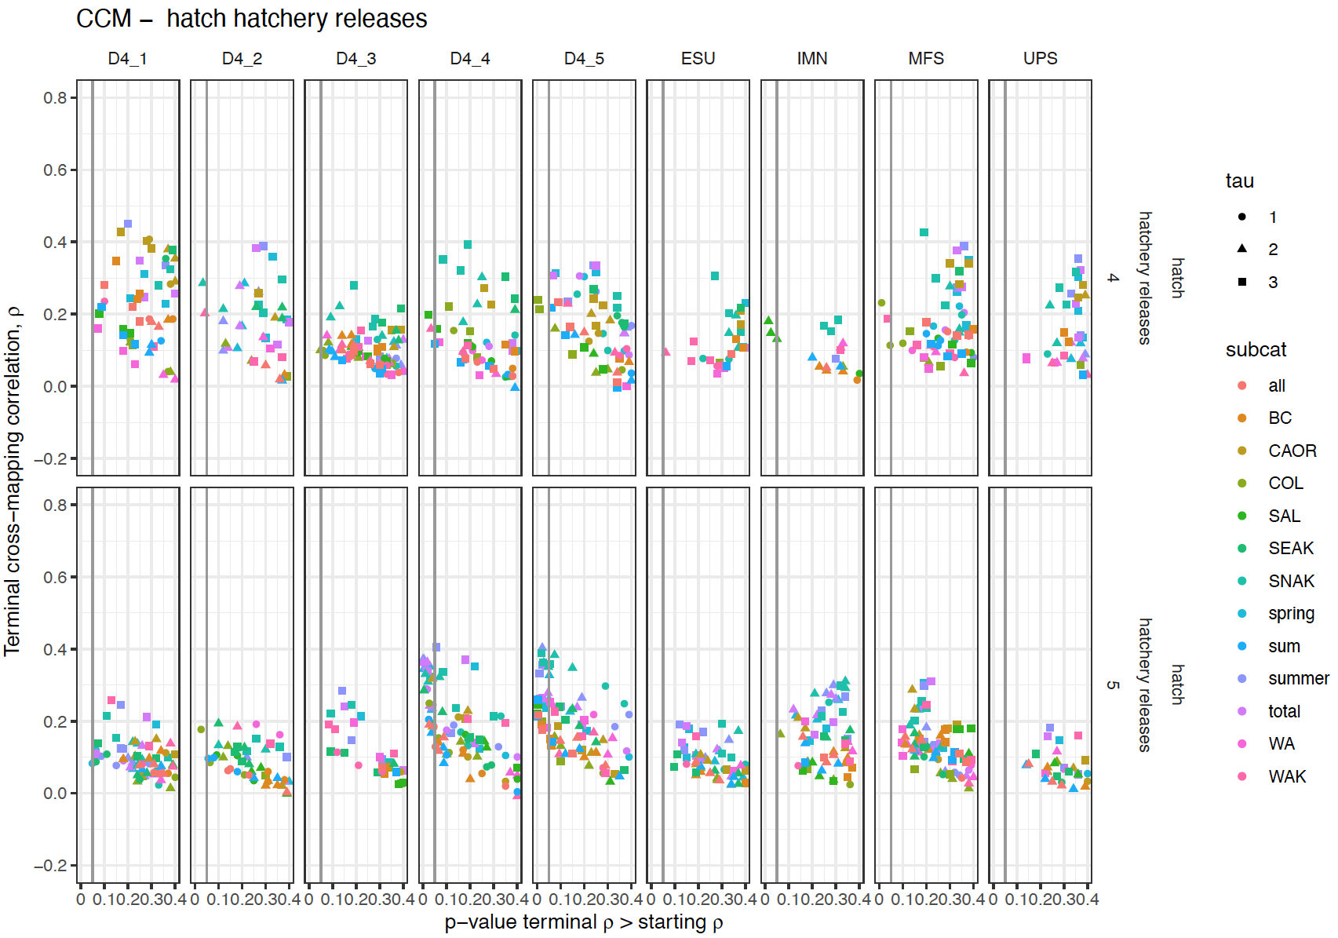
These are the CCM results (for hatchery releases) with 4yo recruits per spawner data on the top row and 5yo on the bottom. Each column is a different grouping of stocks. ESU include all stocks, IMN, MFS and UPS are the different MPGs. D4_1 through D4_5 are the groupings from the hierarchical analysis on slide 1. The terminal rho of the CCM is plotted against it’s p-value of the test that it is higher than the minimum library rho.
Note that many hatchery releases (particularly the SNAK) are only significantly causally related to the the hierarchical groupings and with a higher rho.

Slide 3
Middle Fork Salmon
4 year old recruits per spawner
MFS_1
MFS_1
Loon Creek and Marsh creek are very similar for rec4 but not for rec5.
5 year old recruits per spawner
MFS_2
MFS_2

Slide 4
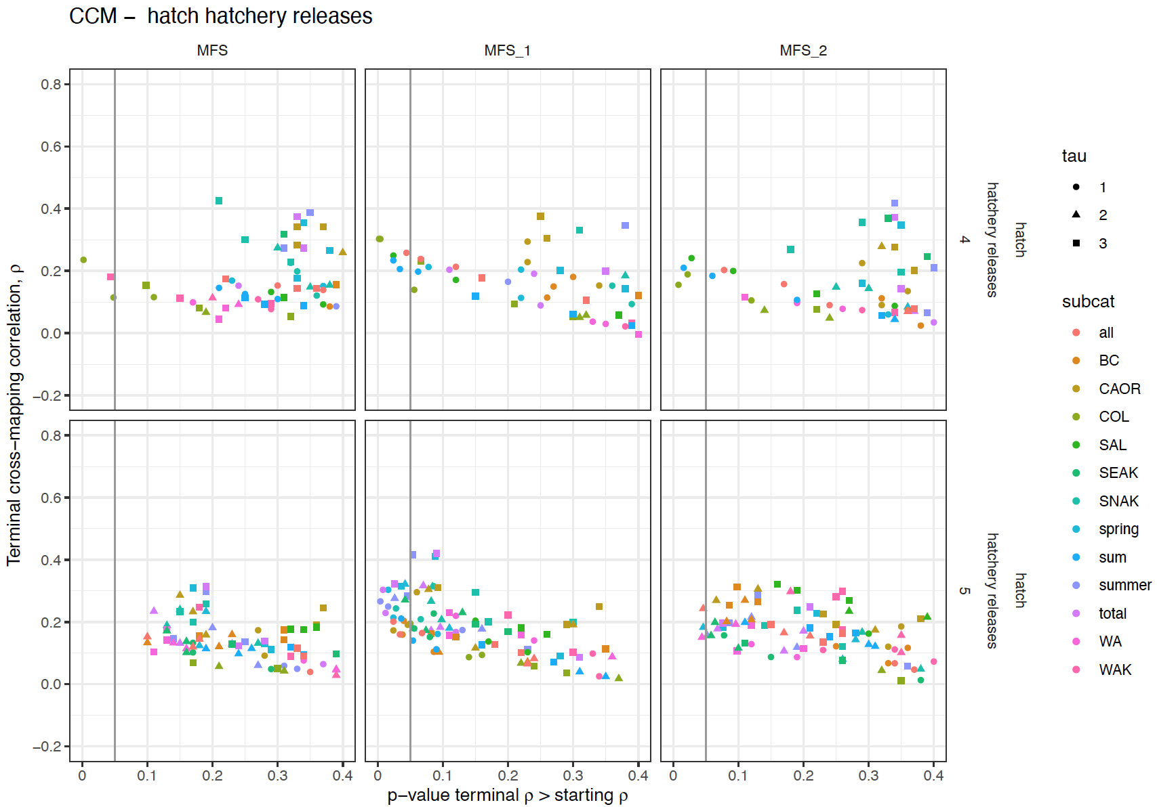
For Rec4, the smaller clusters show additional causal variables
For 5-year old recruits the effects are significant in the smaller clusters and with a higher rho.

Slide 5
Upper Salmon
UPS_1
UPS_1
4 year old recruits per spawner
The Salmon River above and below Redfish Lake are very similar for rec5 but not for rec4.
UPS_2
UPS_2
5 year old recruits per spawner
UPS_3

Slide 6
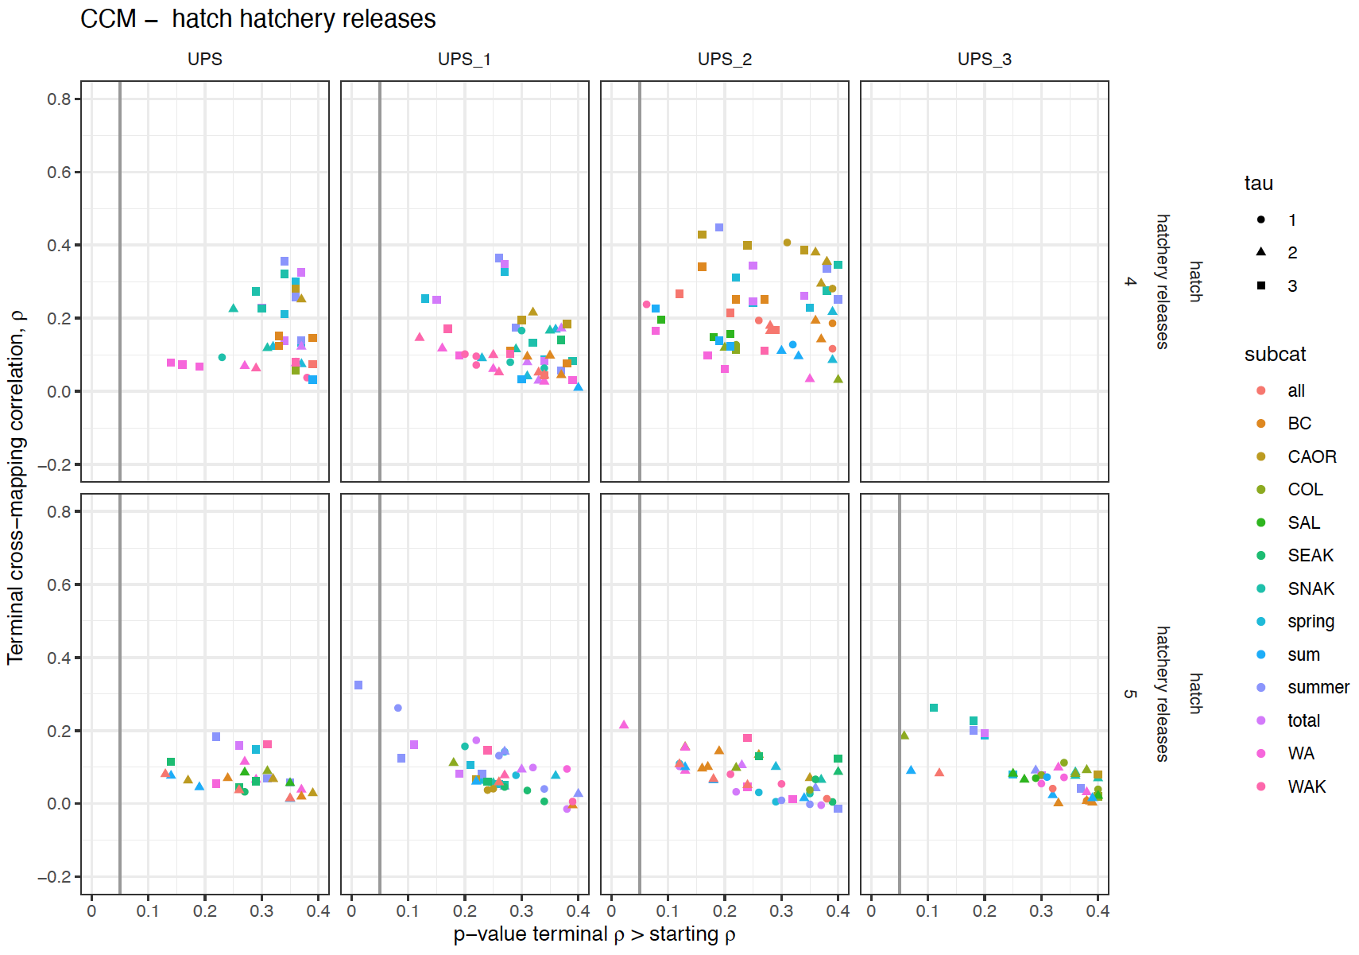
Different variables are causal for rec5 in the smaller USP clusters

Slide 7
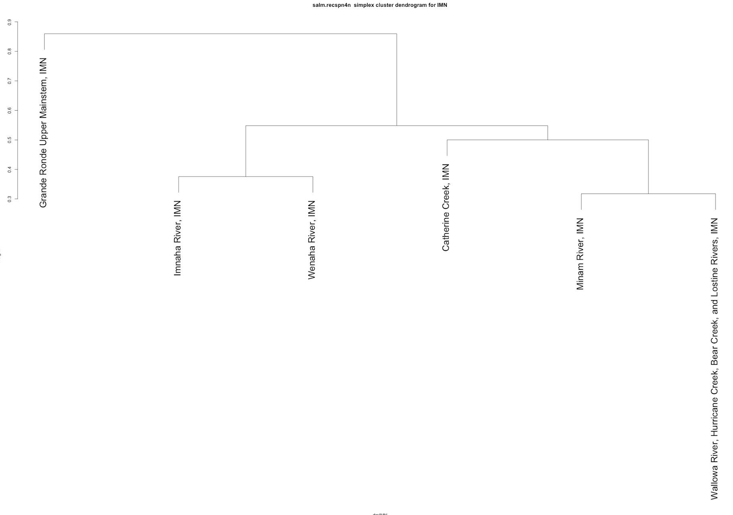
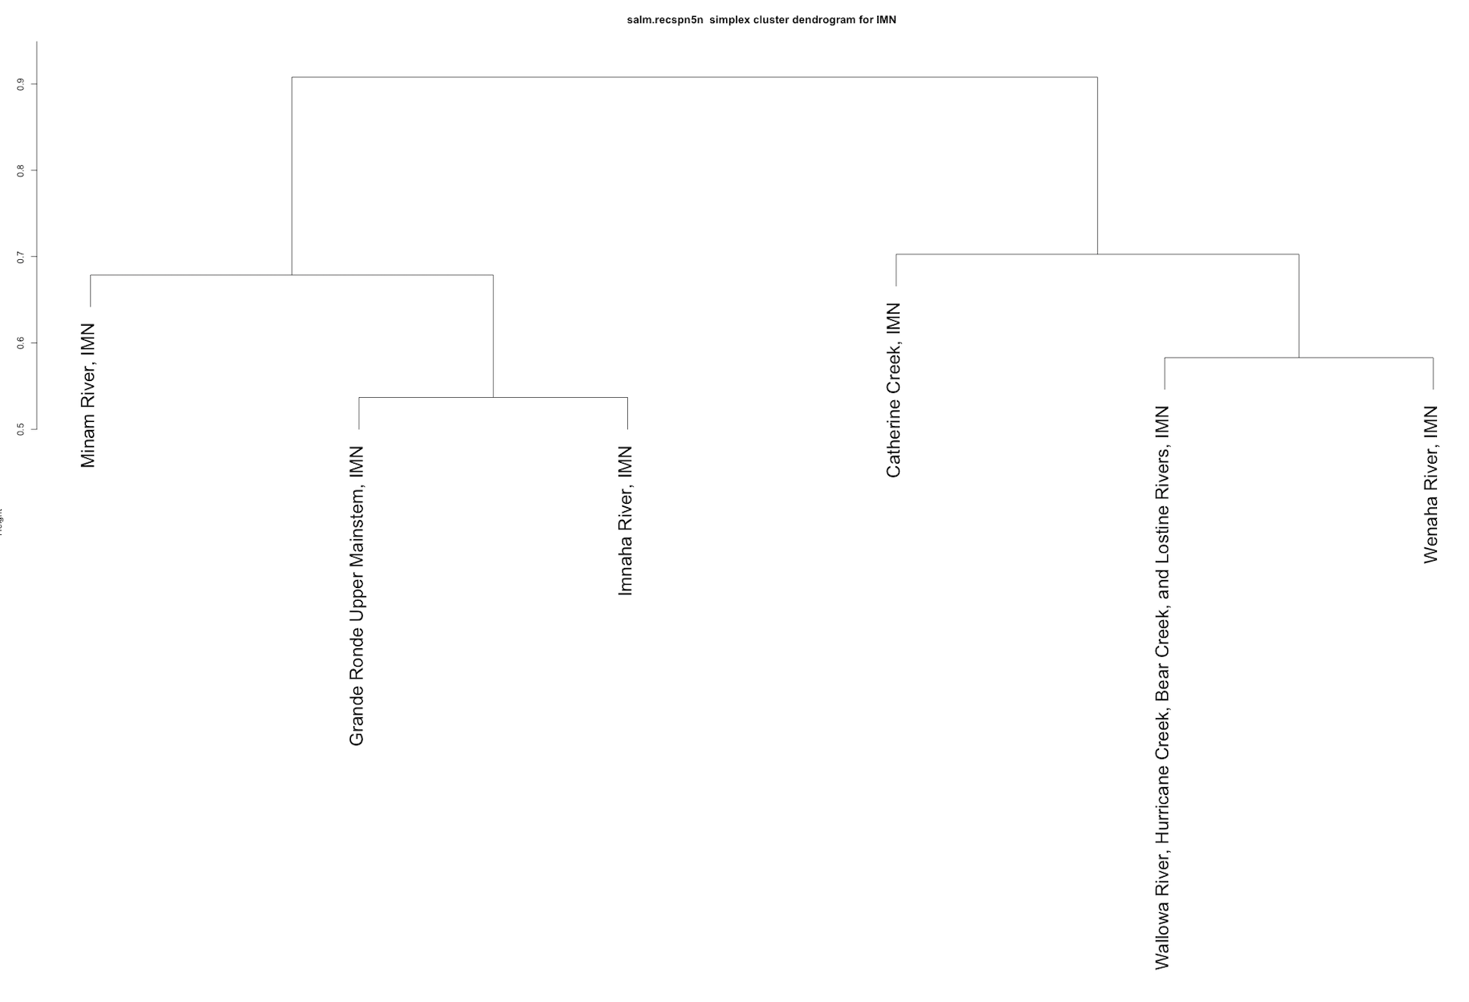
4 year old recruits per spawner
Imnaha
5 year old recruits per spawner
IMN_1
IMN_1
IMN_2
IMN_2
Lostine River and Wallowa contain the same data. Need to rerun this analysis without Lostine R. Explains why they predict each other so well for both rec4 and rec5.

Slide 8
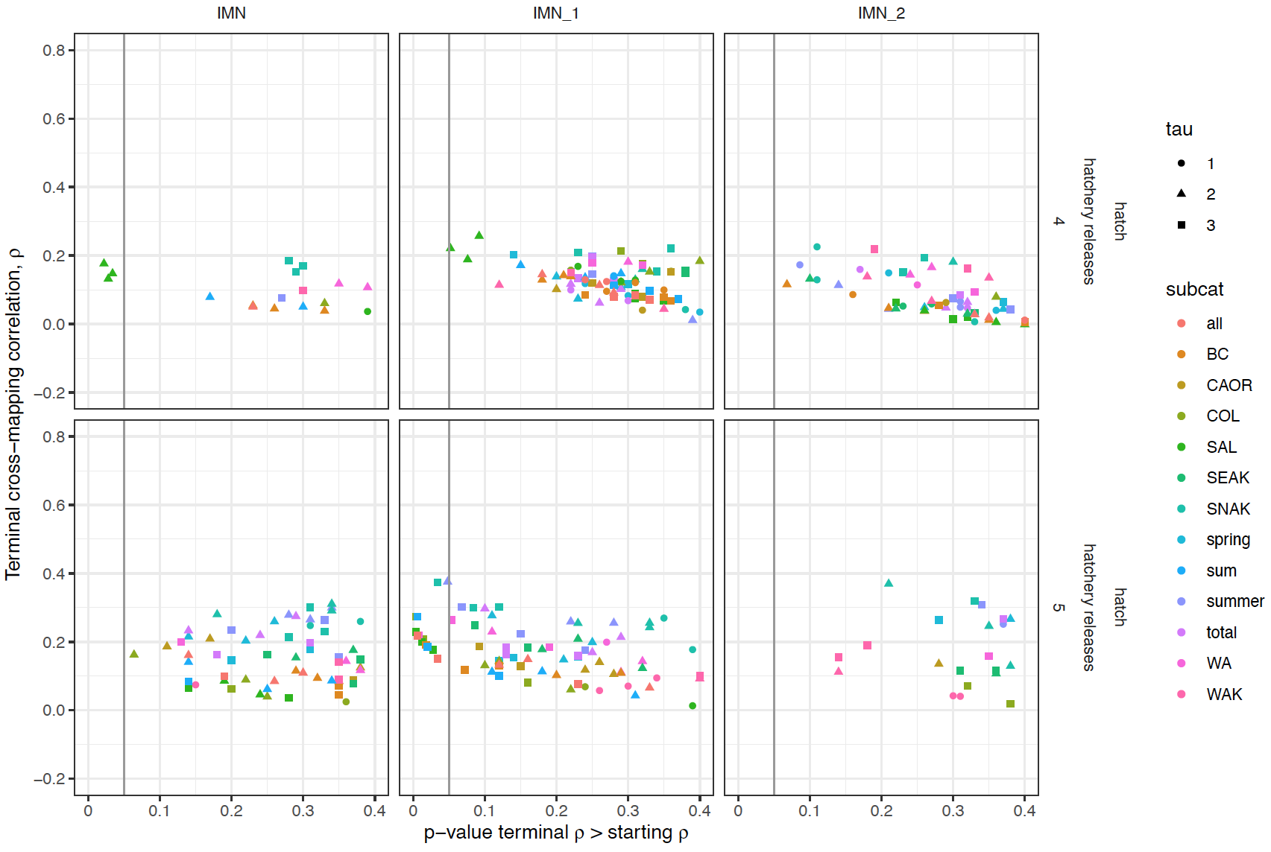

Slide 9
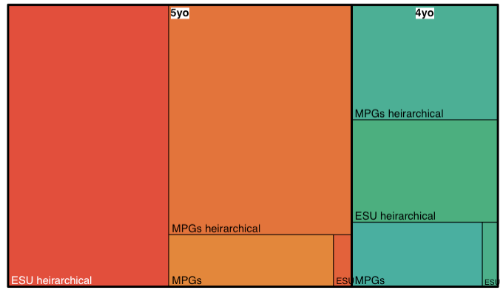
This treemap displays our hierarchical CCM results as a set of nested rectangles. Each group (and subgroup) is represented by a rectangle, in which the area is proportional to the terminal rho from the CCM of all the putative causal variables whose p-value was <= 0.1 (the p-value of the test that the terminal rho is significantly higher than the minimum library rho).
The first grouping is for 5 year old vs 4 year old recruits per spawner. The data for the 5 year old recruits had many more significantly causal variables.
Within each recruit age, you can see how the different ways the Chinook stocks are grouped compare.
‘ESU’ includes all the stocks together in the same attractor. For both 4yo and 5yo recruits, this revealed the least causality. This may be because there are different driving forces between the stocks and they don’t belong on the same attractor so there is little pattern in the attractor for all stocks combined. Alternatively, each stock may be on a different part of the same attractor but the sampling is insufficient or the stochasticity is so high that it can’t be resolved.
‘MPGs’ divides the stocks by the three main MPGs (Middle Fork Salmon, Imnaha, and Upper Salmon). The South Fork Salmon and Lower Snake stocks are not included, but never-the-less, these data do reveal more significant causal signatures.
The stocks were also divided based on the simplex hierarchical analysis. The ‘ESU hierarchical’ arrangement is based on the hierarchical analysis of the whole ESU for 4yo and 5yo recruit per spawner data separately (slide 1). The ‘MPG hierarchical’ arrangement is based on the separate hierarchical analyses of each MPG (slides 3, 5, 7).

Slide 10
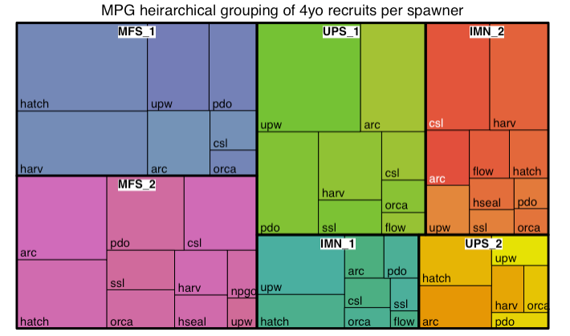
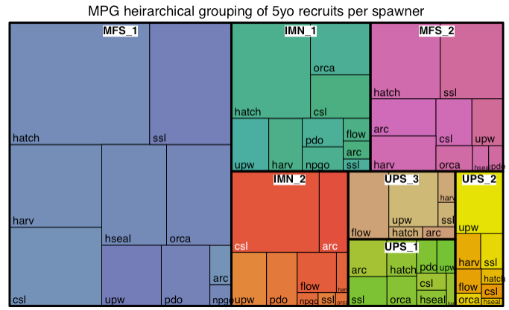

Slide 11
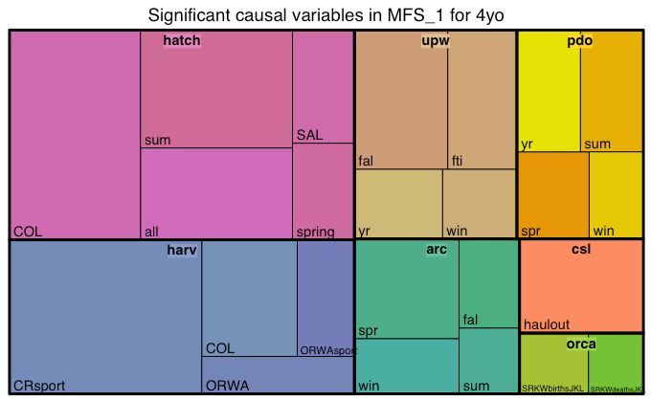
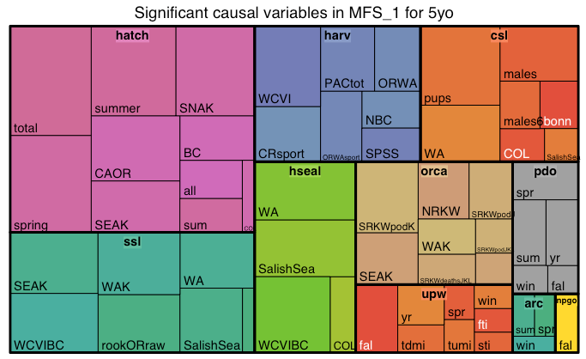
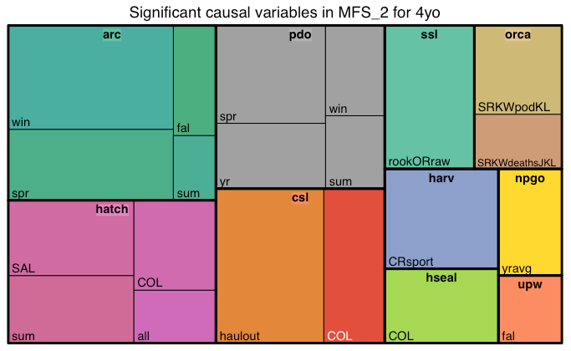
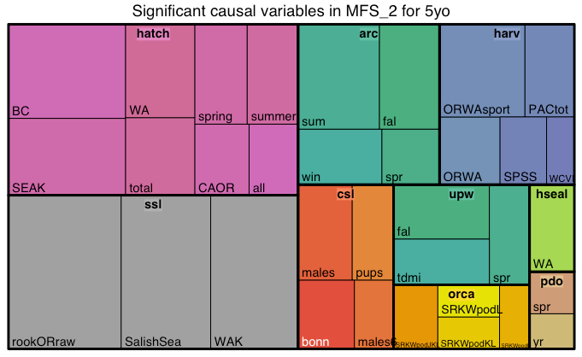
Middle Fork Salmon

Slide 12
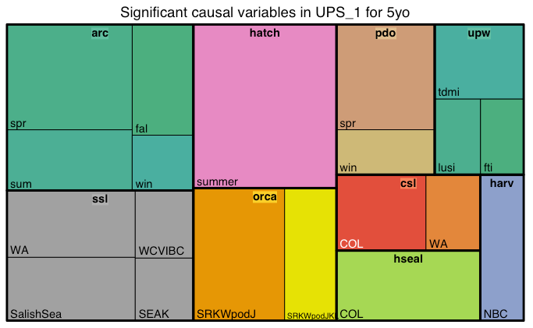
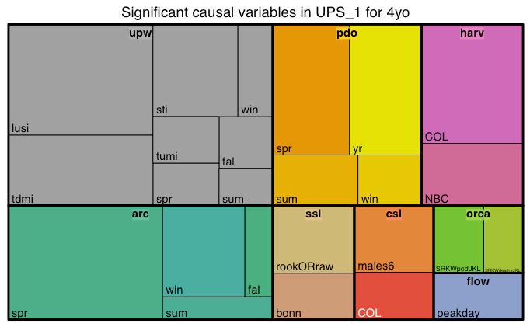
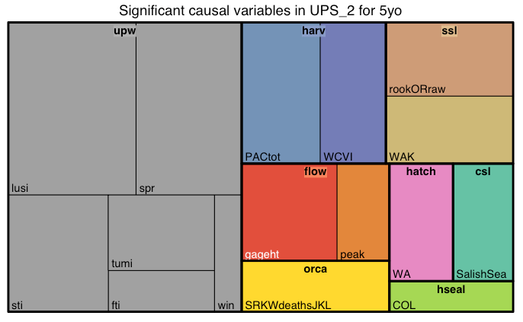
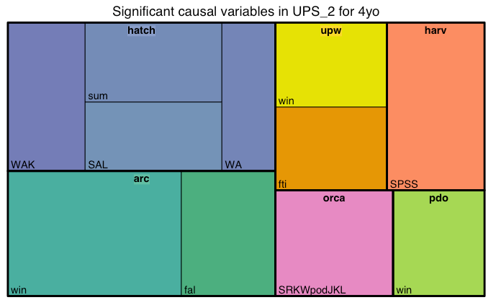
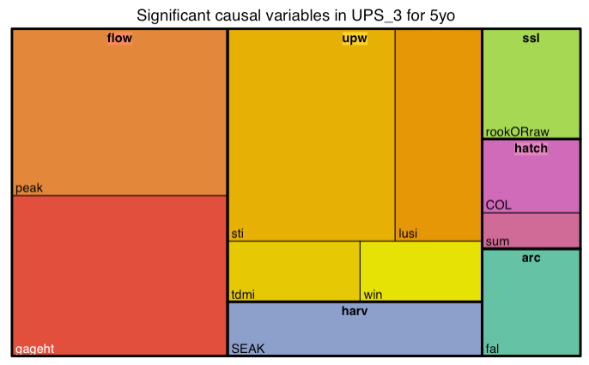
Upper Salmon

Slide 13
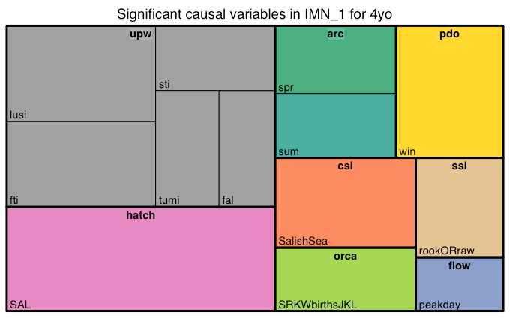
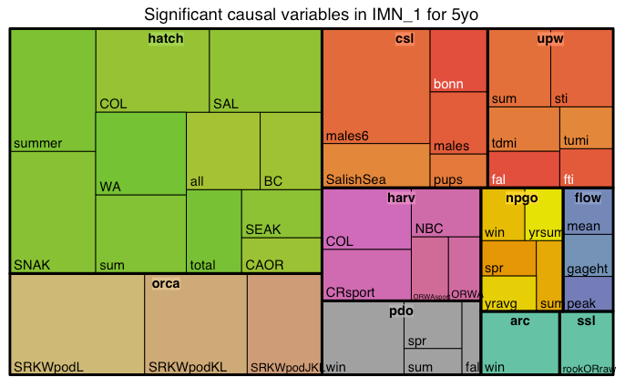
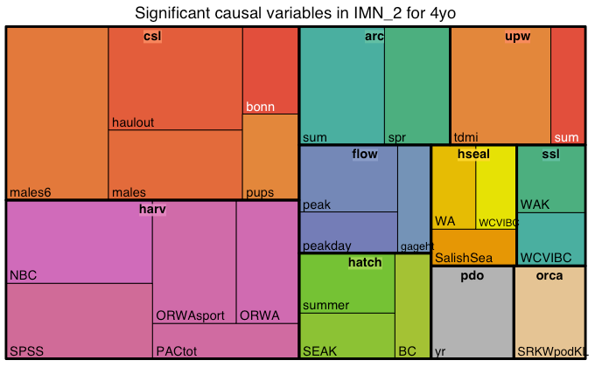
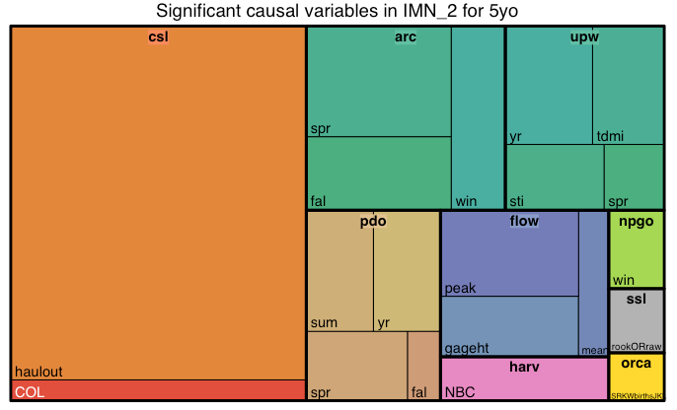
Imnaha

